Slide 1
LAB - 05

Slide 2

Task - 1
Write a program using for loop to display following output.

Slide 3
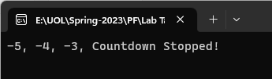
Task - 2
Modify the previous code that if value is equal to -2 then program should terminate the execution.

Slide 4

Task - 3
Modify the previous code that if value is equal to -2 then program should skip that value and continue the execution.

Slide 5
Task - 4
Write a program that uses for loops to perform the following steps:
Prompt the user to input two integers: firstNum and secondNum (firstNum must be less than secondNum).
Output all odd numbers between firstNum and secondNum.
Output the sum of all even numbers between firstNum and secondNum.
Output the numbers and their squares between firstNum and secondNum.
Output the sum of the square of the odd numbers between firstNum and secondNum.

Slide 6
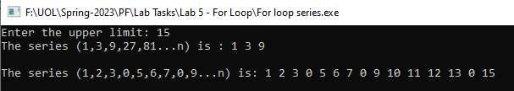
Task - 5
Write a C++ program that accepts an upper limit from the user and it should display the following series up to the upper limit specified in a n variable.
1 3 9 27 81 ... n
1 2 3 0 5 6 7 0 9 ... n

Slide 7
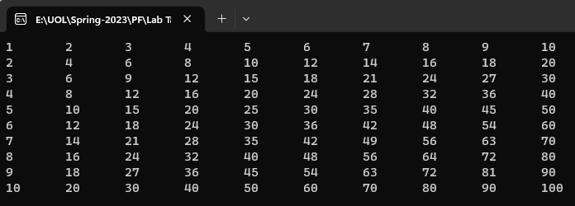
Task - 6
Using nested for loop, write a C++ program that prints multiplication table from 1 to 10.

Slide 8
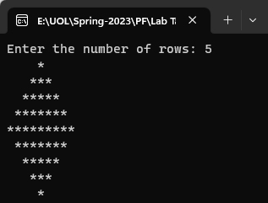
Task - 7
Using nested for loop, write a C++ program that prints diamond stars pattern.

Slide 9
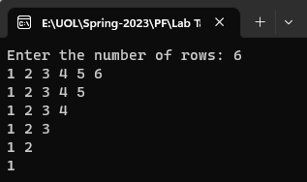
Task - 8
Using nested for loop, write a C++ program that prints following pattern.

